Slide 1
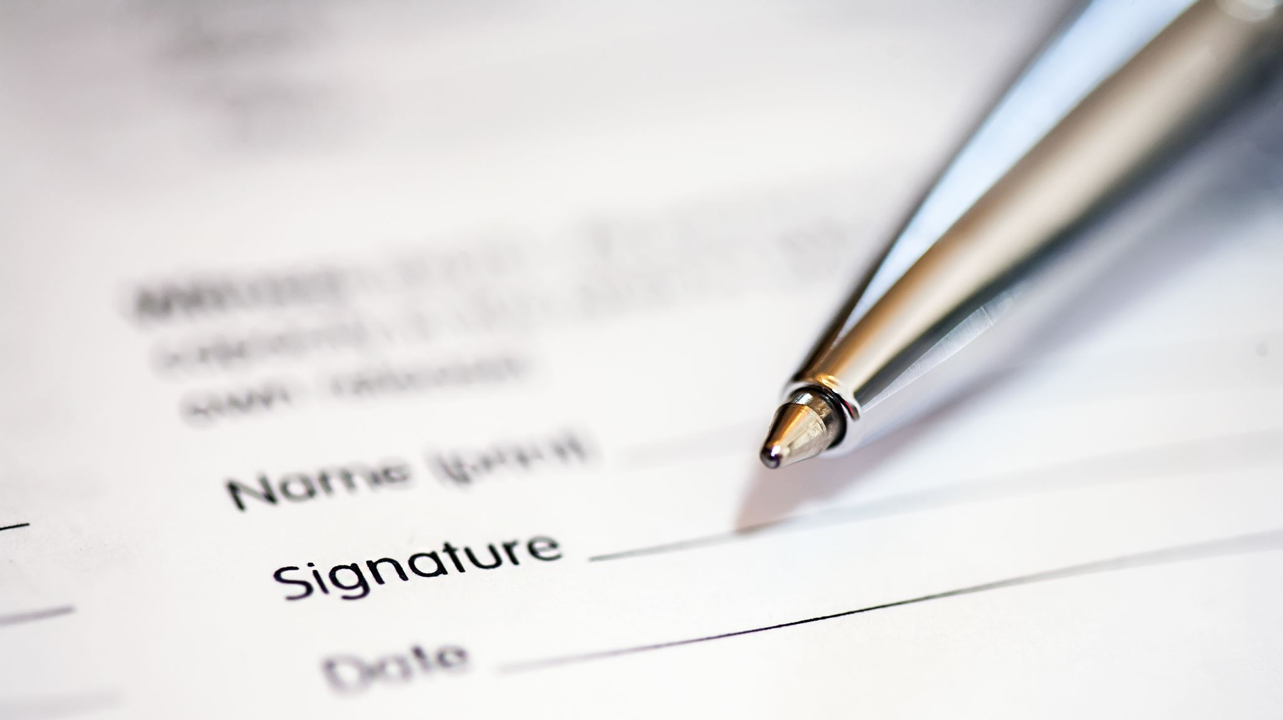
Handwriting Text Recognition Using CNN to Automate Digitization of Documents
Ishika Gupta, Jiyau Zhang, Nikhil Reddy, Supriya Prasad, Tien Le-Dinh
Notes:
Good afternoon to one and all present here. Today my team and I are going to present our final project for the CIS 515 course – Handwriting text recognition using CNN to automate digitization of documents at ASU.

Slide 2
Introduction
PROBLEM STATEMENT
Many important records at ASU are still handwritten
There is a need to automatically digitize handwritten documents in ASU accurately, effectively and easily
class/lab notes
quick calculations
handwritten tests and essays
research material
archival records
administrative forms
Notes:
So, let’s start with the introduction. Even in today’s Information Age, many important records at ASU is still handwritten, for example: in class/lab notes, quick calculations, handwritten tests and essays, research material, archival records, administrative forms, etc. Digitized documents hold several advantages over physical documents and thus there is a critical need for digitizing handwritten documents accurately, efficiently, and easily. This can be achieved by deploying an end-to-end pipeline that automatically recognizes handwriting using computer vision.

Slide 3
Motivation
EXISTING SOLUTIONS AND THEIR PROBLEMS
WHY DID WE CHOOSE THIS PROBLEM / MOTIVATION TO SOLVE THIS PROBLEM
Some records are never digitized
Limited accessibility
Manual digitizing – read and type
Time consuming
Prone to error and inconsistencies
OCR (Optical Character Recognition) Capabilities of flatbed scanners
Quality of source material / document
Inefficiency in document sharing and collaboration
Physical storage space requirements
Limited scalability
Risk of damage to fragile documents
Desk / physical space for flatbed scanner
Improved accessibility of documents
Ease of use
Reduce cost – labor and storage
Reduce time waste
Reduce human error and inconsistencies
Notes:
Before we jump into solving this problem, lets take a look at how the problem is being solved currently, what their problems are, and how we can bridge this gap.
Well, first, some records are never actually digitized. People / companies are still keeping physical records and are working with them as is. This is problematic because physical documents have storage requirements, which can be costly, and they also have limited accessibility because document sharing and collaboration is difficult.
The second solution is to digitize documents manually where a human reads the physical documents and types it in. There are problems with this as well since manual digitization is extremely time consuming, prone to error and inconsistencies.
The third solution, the one that ASU uses, is automatic digitization of documents, but with a flatbed scanner that has optical character recognition capabilities. Flatbed scanners consist of a flat glass-like surface onto which the physical document is placed. The lid is closed to cover the document which is then converted to a soft copy. OCR is a technology that takes in scanned documents as inputs, recognizes and extracts text characters from the documents, and makes them editable and searchable electronically. This is better than manual digitization, but this also faces problems. The performance is highly dependent on the quality of the source document. It will not work well with old or fragile documents and there is a risk of document damage as well. It also is costly because desk space is needed for a flatbed scanner.
So, we can see that there are multiple issues with the existing solutions. We want to propose a solution that will overcome these problems. We want to improve the accessibility of documents by digitizing documents, we want to make it automatic so that we can reduce on labor and storage costs, save up on time, reduce human error and inconsistencies and make the overall process easy and convenient to use.

Slide 4
Key Stakeholders and Beneficiaries
Faculty and Students
Easier and faster access to course and research materials
Librarians
Can serve faculty and students effectively due to improved digital learning resources
Administrative staff
Streamlined administrative processes due to improved digital record keeping of applications, transcripts and financial aid forms
Notes:
So, who will our solution benefit?
Firstly, faculty and students get easier and access to course and research materials due to efficient digitization of documents.
The librarians on campus will be able to serve the faculty and students because with our solution, they will have access to and can manage improved digital learning resources.
ASU also has a lot of administrative documents like applications, transcripts and financial aid forms, which when efficiently digitized can improve digital record keeping and streamline administrative processes.

Slide 5
Proposed Solution
Upload source documents to the web app
Convert to images
Pre-process images
Detect & localize lines of text (CV task 1)
Handwriting Text Recognition (CV task 2)
Combine lines of recognized text into 1 output
Prompt users to download output
Delete output after download is completed
Pre-process line-of-text images
Notes:
This is our proposed end to end solutions to achieve our goal. The final solution Is going to be a web app which will allow the end user to upload the document they want to digitize. The document is then converted to an image because the document uploaded by the user is not always going to be an image. For example, it can be a pdf or word doc. Once we have the images, we will have to use CV to identify each line and save it as a separate image. Once we have images where each image is an individual line, we preprocess the image based on the needs of our model. So, this is the part of the end-to-end solution lifecycle that we worked on. We use CV again to go through all line images of a document and identify and predict the characters on them. We concatenate the predictions and store it in a word doc which the user will have access to.

Slide 6
Success Metrics
Character error rate (CER)
User adoption rate
Robustness to variation
Generalizability
Notes:
We measure the performance of our model by evaluating the following success metrics.
The first metric is going to be the character error rate to measure the accuracy of transcribing the handwritten text. It measures the percentage of characters incorrectly recognized when compared to the ground truth.
We also have the loss value that we get as we train the model through multiple epochs to understand how the training is going and if the model is learning well.
We check if the model is robust against variation – that is, we check if the model is able to perform well when the background and lighting of the image changes.
Finally, we check if the model is able to generalize – the model was trained on the IAM dataset – it has not seen our handwriting yet. We test if it is able to transcribe our handwriting as well.

Slide 7
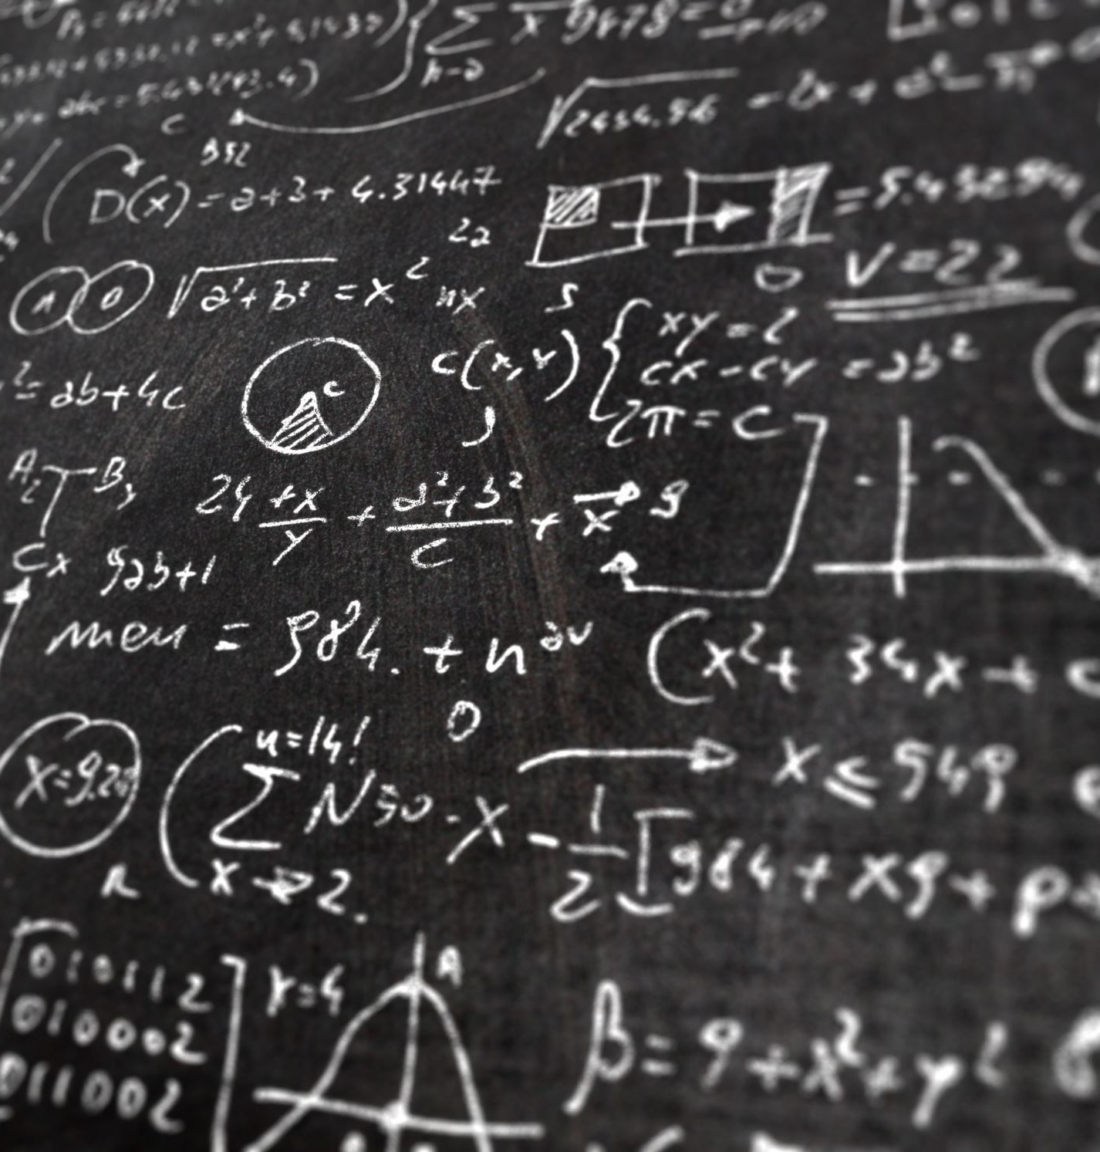
Data Acquisition
Subset of the IAM Dataset.
Created by the Institute of Computer Science and Applied Mathematics (IAM) at the University of Bern, Switzerland
Contains handwritten text at the word, line, and form level from 657 writers.
Our project will use the 13353 line images (labeled).
Notes:
So, now that we had our problem and goal statement defined, the next step in developing and implementing our solution was getting our hands on some data to train our model on.
For this project, we utilized the IAM dataset. It is a popular benchmark dataset for handwriting recognition that was created by the Institute of computer science and applied mathematics at the university of Bern, Switzerland.
It contains images which contain only a single word, images that have only a single line, and images that have paragraphs of handwritten text. The text was written by 657 writers, so there are different styles of handwriting present in the dataset which can help with generalizability.
One thing to note is that only the word and single line images have the ground truth associated with them and are thus labeled. The images that have paragraphs of text on them do not have any ground truth associated with them.
For this project, we worked on the single line images and its ground truth to train the model.

Slide 8
Data Preprocessing
Normalization – make pixel values between 0 and 1
Use greyscale image only
Resize and scale all images to same size
Notes:
Before we jump into building the model, we need to prepare the data for our model.
First, we normalize the pixel values to fall into the range of 0 and 1 instead of 0 to 255 for better model performance.
We then make sure the color channels for all images are in the same order and are in the order the model expects them to be.
Finally, we resize and scale all images to the same size.

Slide 9

Data Augmentation
Vertical tiling and corruption (TACo) augmentation is applied to training data to help reduce overfitting.
Vertical TACo augmentation replaces random vertical slices of the image with noise.
Notes:
To improve the generalizing capability of our model, we apply vertical tiling an corruption augmentation to our training data.
Specifically, we replaces random vertical slices of the image with noise. This forces the model to learn to recognize character in less-than-ideal situation which is the norm in handwriting.

Slide 10

Feature & Label Engineering
No further feature/label engineering is carried out.

Slide 11
Handwriting Recognition Model Building Using Only 1D-CNN
We use EASTER (Efficient and Scalable Text Recognizer) architecture (Chaudhary and Bali 2022).
Key advantages:
Less parameters -> computationally efficient
Simpler architecture -> easier to understand
Chaudhary, Kartik, and Raghav Bali. "Easter2. 0: Improving convolutional models for handwritten text recognition." arXiv preprint arXiv:2205.14879 (2022).

Slide 12
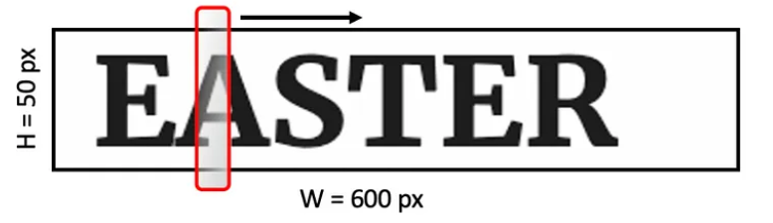
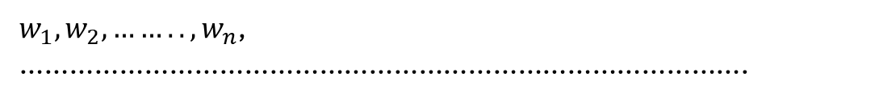
Motivation for Using 1D-CNN
A line of text can be conceptualized as a time-series of pixels along a line.
One dimensional convolution is then a sliding window along a text line. Each window captures some features of a character.
$w_{1},w_{2},……..,w_{n}$, …………………………………………………………………………….
Chaudhary, Kartik. “1D-CNN Based Fully Convolutional Model for Handwriting Recognition.” Medium, September 24, 2020. https://towardsdatascience.com/1d-cnn-based-fully-convolutional-model-for-handwriting-recognition-7853976f5784.

Slide 13
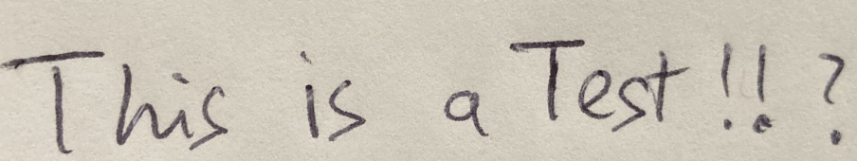
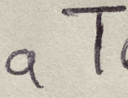
Motivation (cont)
a
a
‘ ‘
T
T
T
remove duplicates
‘ ‘
0.0
0.0
1.0
0.0
0.0
0.0
output = ‘a T’
a
0.7
0.8
0.0
0.0
0.0
0.0
b
0.0
0.0
0.0
0.0
0.0
0.0
size of alphabet = 79
…
…
…
…
…
…
…
T
0.0
0.0
0.0
0.7
0.9
0.6
…
…
…
…
…
…
…

Slide 14
Block B
SE module
Squeeze & Excitation
Length x Channel
Block A
Block A
Block A
Conv1D
BatchNorm
SE
Block A
Avg Pool
C x 1
FC Relu
Block B
ReLu
Dropout
C/8 x 1
Block A
Conv1D
BatchNorm
SE
Block A
FC sigmoid
C x 1
Block B
ReLu
Dropout
Block A
Conv1D
BatchNorm
SE
Length * Channel
Block A
Block A
Dense Residual Connection
Conv1D
ReLu
Dropout
Block C
Batch-Norm
1x1 Conv1D + Batch-Norm
Block A
Block A
Conv1D
ReLu
softmax
Dropout
For training, output layer is connected to a lambda layer with CTC-loss function.
CTC Loss

Slide 15
Block | Implementation Details (padding = same) | Output Shape | Number of Parameters (weights & bias)
<<<Input>>> | Input(shape=(2000, 80))
1: block A | 1 CONV layer, 128 filters, size 3, stride 2 | (None, 1000, 128) | 31,360
2: block A | 1 CONV layer, 128 filters, size 3, stride 2 | (None, 500, 128) | 49,792
3: block B | 3 CONV layers, 256 filters, size 5, stride 1 1 Dense, 1x1 CONV Residual Connection 1 Squeeze-and-Excitation | (None, 500, 256) | 907,808
4: block B | 3 CONV layers, 256 filters, size 7, stride 1 1 Dense, 1x1 CONV Residual Connection 1 Squeeze-and-Excitation | (None, 500, 256) | 1,530,400
5: block B | 3 CONV layers, 256 filters, size 9, stride 1 1 Dense, 1x1 CONV Residual Connection 1 Squeeze-and-Excitation | (None, 500, 256) | 1,923,616
6: block A | 1 CONV layer, 512 filters, size 11, stride 1, dilation 2 | (None, 500, 512) | 1,444,352
7: block A | 1 CONV layer, 512 filters, size 1, stride 1 | (None, 500, 512) | 264,704
8: block C | 1 CONV layer, 80 filters, size 1, stride 1 Activation softmax | (None, 500, 80) | 41,040
 |  | Total Parameters | 6,193,072

Slide 16
Block B Details
Input 1
Input 2
Block A
Conv1D (1x1)
Conv1D (1x1)
Block A
Batch-Norm
Batch-Norm
Conv1D
Batch-Norm
Squeeze & Excitation
ReLu
Dropout
Output 1
Output 2

Slide 17

Weight Initializer & Training Details
‘he_uniform’ kernel initializer in all convolution layer
Adam optimizer starting with learning rate = 0.01
Batch size = 32
102 epoch
Training time per epoch ~630 sec on a 8-cores, 16-threads CPU

Slide 18
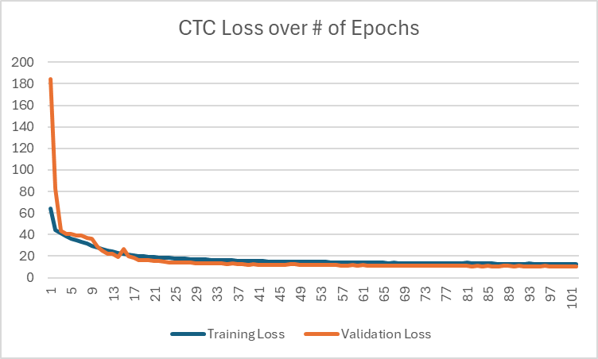
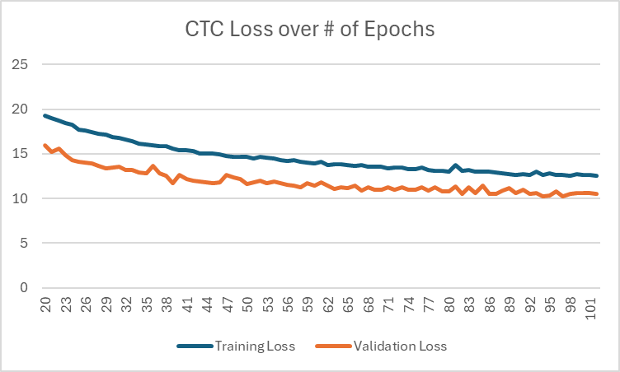
Model Evaluation - Loss over # of Epochs
Validation loss is lower because:
Data is not subjected to Tile-and-Corruption augmentation.
Loss is calculated once vs average across whole epoch in training.

Slide 19
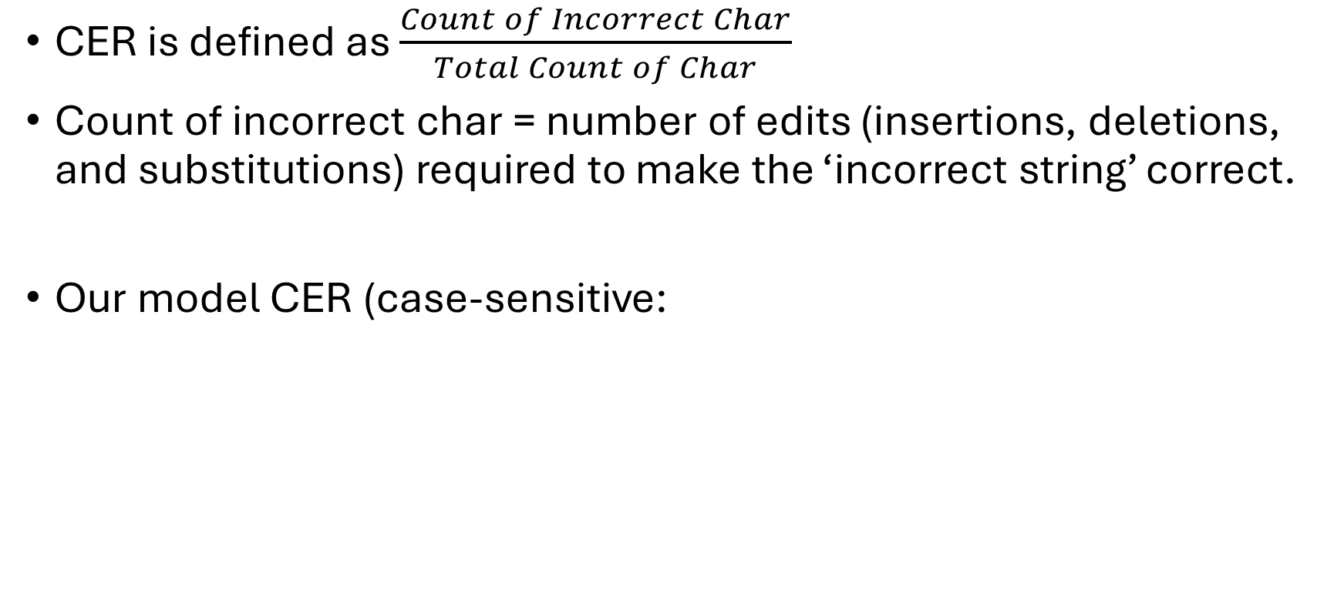
Model evaluation - Character Error Rate (CER)
CER is defined as $\frac{Count of Incorrect Char}{Total Count of Char}$
Count of incorrect char = number of edits (insertions, deletions, and substitutions) required to make the ‘incorrect string’ correct.
Our model CER (case-sensitive:
 | # of Incorrect Char | # of Char | CER
Our weights (102 epochs training) | 15,653 | 125,314 | 12.4910%
Pre-train model from EASTER2 authors | 9,952 | 125,314 | 7.9417%

Slide 20

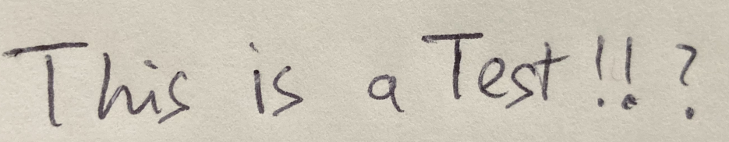

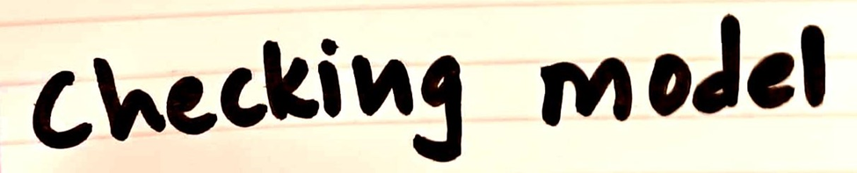
Model results - Demo

Slide 21
Validation, Monitoring, and Maintenance
Pre-Deployment
Post-Deployment
Usage of a portion of the training dataset as validation data
Check evaluation / success metrics
Continuous performance (evaluation / success metrics) monitoring
Collect regular feedback from end users
Retraining model with new data
Maintain documentation regarding updates and lessons learnt
Notes:
To validate our model before deployment we made use of a portion of the training dataset as the validation dataset and we evaluated our model multiple times on unseen data, like our handwriting to evaluate the model on its character error rate and generalizability.
Once the solution is deployed, we need to monitor it continuously to ensure that the model continues to work well in the future as well. We can do this by collecting regular feedback from the end users, logging the results from the deployed model and retraining the model from time to time and maintain documentation regarding performance, updates and lessons learnt for future reference.

Slide 22
Potential concerns and solutions
Data privacy and breach
Handwritten documents may contain sensitive information such as name, addresses, and financial data
Inadequate security measures can lead to exposure of sensitive information
Solution
Implement encryption methods to protect data in transit – when uploading documents
User consent and transparency – take explicit consent and policies
Notes:
We always have to take into account data privacy and security when working with data.
We know that handwritten documents may contain sensitive information such as name, addresses, and financial data and inadequate data security and encryption measures can lead to exposure of sensitive information.
To resolve this, we need to implement good and strong encryption methods to protect data in transit – when uploading and downloading documents. The solution should be transparent in that the users’ explicit consent should be taken when they upload their documents and that they should be aware about that their data is being analyzed.

Slide 23
Future scope
Multilingual support
Extend solution to understand handwriting in multiple different languages – not just English
Infrastructure
Deploy the solution on the cloud to leverage scalability in terms of varying workloads and user demands
Notes:
But our solution is not complete, there is always scope of improvement. Our solution only understands handwritten text in English – we would like to extend our solution so that it transcribes handwritten text in multiple different languages – making the solution accessible to as many people as possible – not just English understanding audiences.
Furthermore, we want to deploy the solution on the cloud to leverage scalability in terms of varying workloads and user demands.

Slide 24
THANK YOU
Ishika Gupta, Jiyau Zhang, Nikhil Reddy, Supriya Prasad, Tien Le-Dinh

